Slide 1
Vishnevets – U.S. Immigration
Based on Ellis Island Immigration Data 1892 - 1923

Slide 2
Vishnevets Immigration to the U.S.

Slide 3
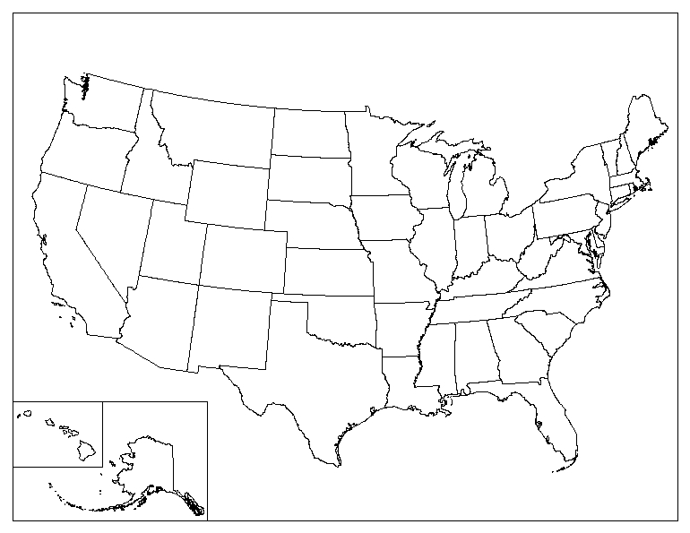
Vishnevets - U.S. Destination Cities
Boston
57
Omaha
4
NY/NJ
362
St. Louis
57
Philadelphia
33

Slide 4
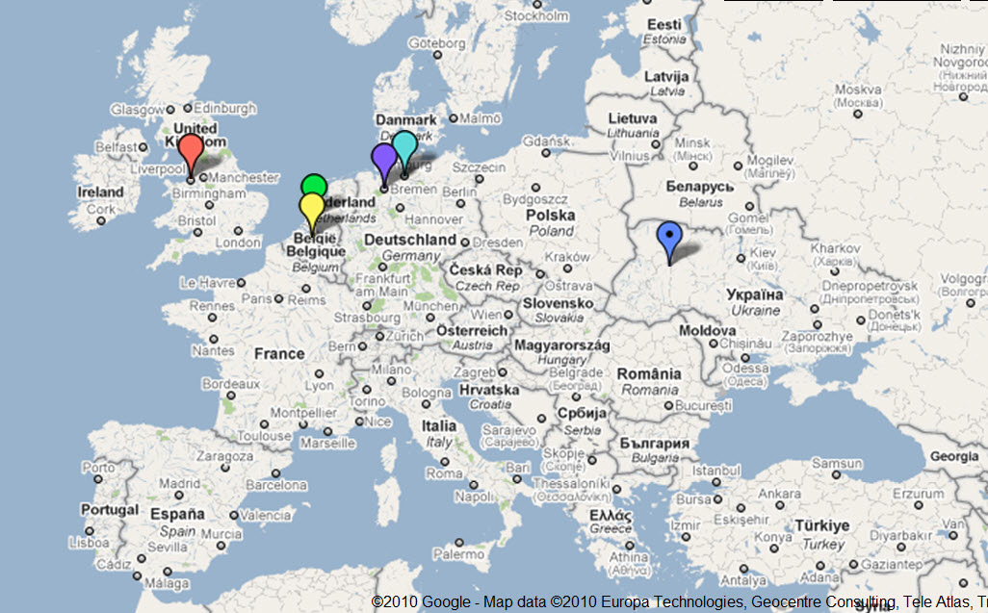
European Exit Ports
Rotterdam - 131
Antwerp - 232
Bremen -34
Hamburg – 93
Danzig - 114
Liverpool - 33
Vishenevets

