Slide 1
Shumsk – U.S. Immigration
Based on Ellis Island Immigration Data 1892 - 1923

Slide 2
Shumsk Immigration to the U.S.

Slide 3
Shumsk - U.S. Destination Cities
Boston
22
Omaha
55
NY/NJ
166
St. Louis
22
Philadelphia
25

Slide 4
European Exit Ports
Rotterdam - 61
Antwerp - 109
Bremen -37
Hamburg - 65
Liverpool - 33
Shumsk

Slide 5
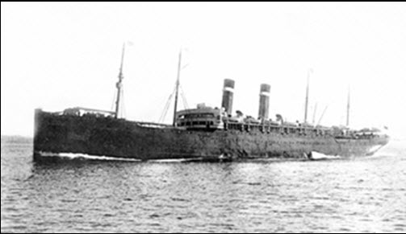
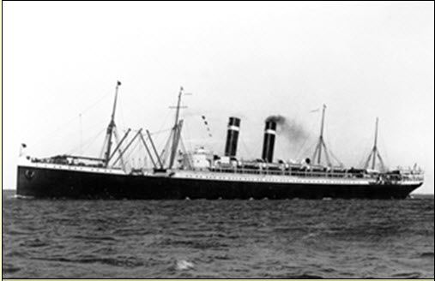
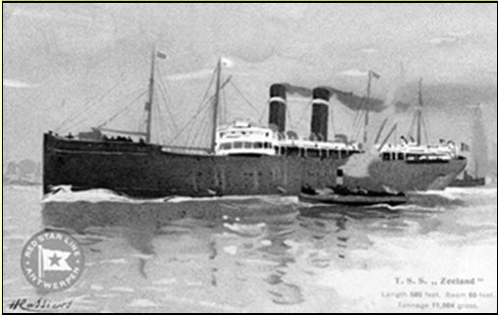
Most Popular Ships
Lapland
Vaderland
Kroonland
Zeeland

Slide 6
Ellis Island Records
Passenger Name, Age, Profession, Destination
Name and Address of Closest Relation at Last Residence
Name and Address of Closest Relation at Destination
Place of Birth
This data has never been digitized or correlated before

Slide 7
Family Connections
Ofengendler / Pelz
Raisher/ Segall/Borgman
Roichman/Blufstein/Lerner/Sheinman
Weiner/ Szprecher/ Szuchman
Weiner/Spieher/Weier
Yeninger/ Rosenberg/ Hechtman
Fuchs/ Tabak
Ackerman/Sherman

Slide 8
Yaninger Family Example
August 1908 – Eidel Yaninger (age 20) leaves her father Abram Yaninger in Shumsk, and travels via Hamburg to New York
Eidel stays with her Uncle Henoch Rosenberg (426 East 9th Street)
Eidel has traveled with 3 Rosenberg children aged 7, 9, and 10. They are leaving behind their grandmother Malke Hechtman in Shumsk to meet their father Henoch Rosenberg in New York.
December 1908 – Chaim Yaninger, age 20, leaves his father Abram Yaninger in Shumsk, and travels via Hamburg to New York.
Chaim arrives in New York and stays with his sister Eidel and his Uncle Henoch Rosenberg (426 East 9th Street)
November 1909 – Moishe Yaniger, age 17, leaves his father Abram Yaninger in Shumsk, and travels via Bremen to New York
Moishe arrives in New York to stay with sister Eidel Yaninger (now living at 144 Houston Street)
June 1910 - Rissel Yaninger, age 24, leaves his father Abram Yaninger in Shumsk, and travels via Rotterdam for New York
Rissel arrives in New York to stay with his brother- in-law L. Cherwitz (83 Cannon Street, New York)
January 1911 – Abram Yaninger age 47 and his wife Basie Yaninger age 46, finally leave Shumsk via Rotterdam with a 16 year old son Kaufzie . They leave behind Abram’s brother Jossel in Shumsk.
They arrive in New York and stay with their son Chaim (who is now living at 299 East 8th Street, New York.)

Slide 9
Summary
Many threads can be woven with this information – specifically inter-Family relationships
Shumsk (348 names) (complete)
Vishnevets (689 names) (complete)
Kremenets ( 1445 names) (in progress)
Identification of family name changes in U.S.
Gelichen -> Geller
Weisblitt -> Wise
Kupperman -> Kupper
Street addresses can be used to lookup additional family information via U.S. Census records which are publicly available or through www.Ancestry.com

